Slide 1
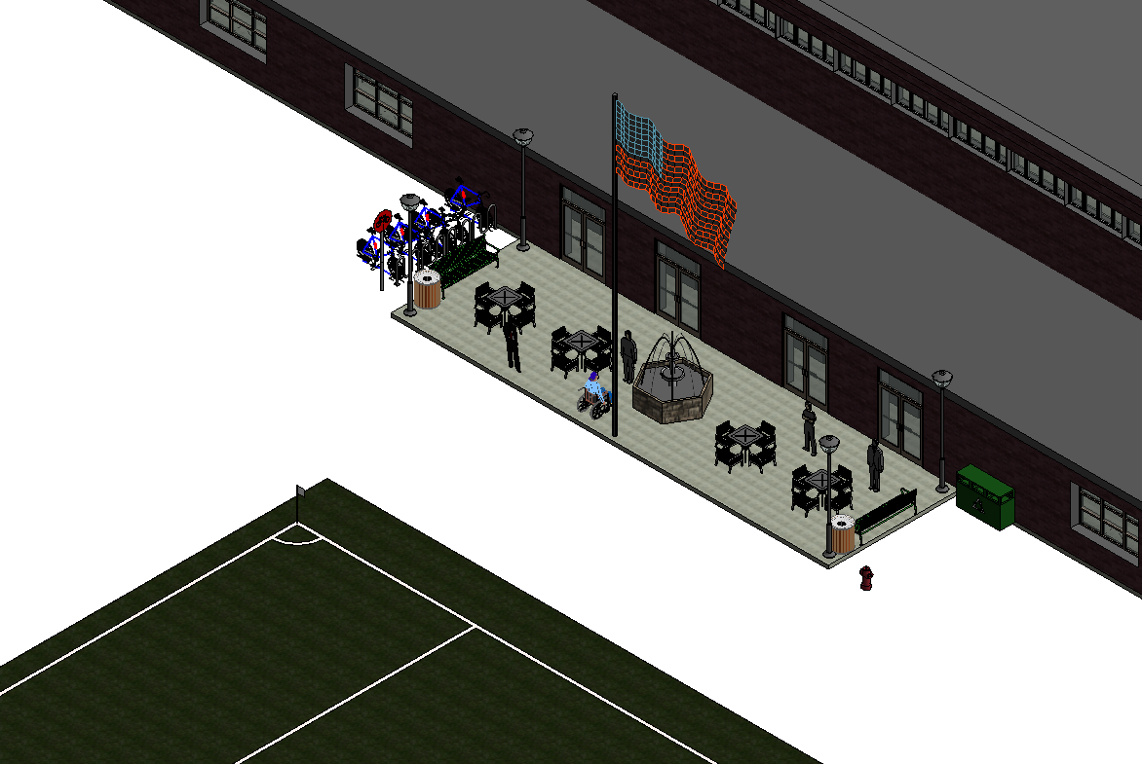
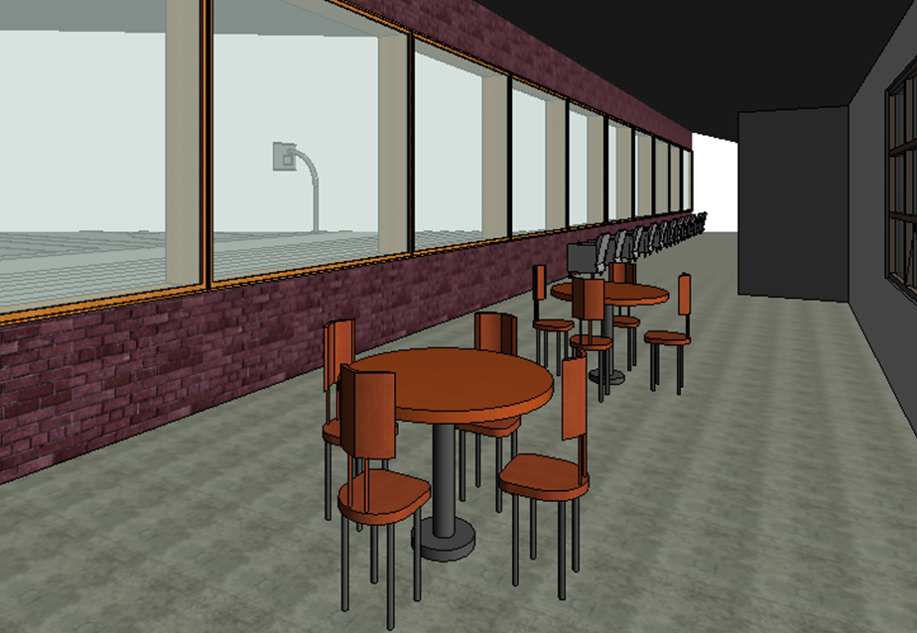
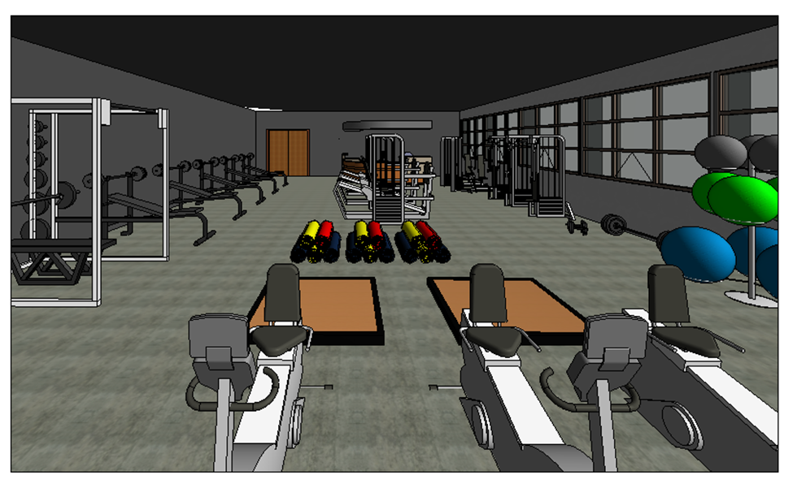
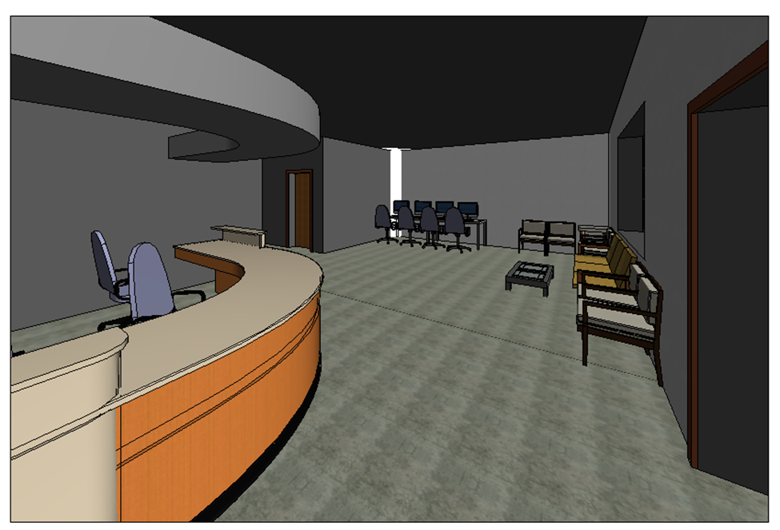
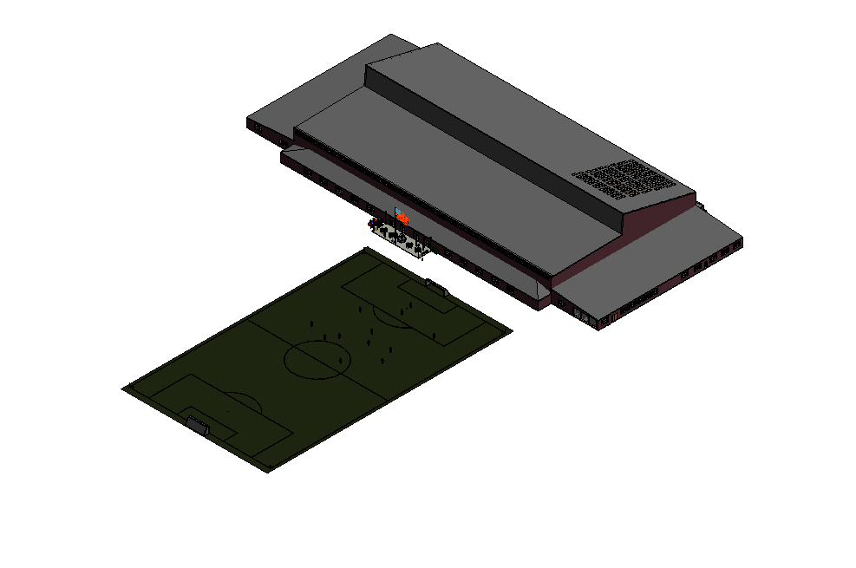
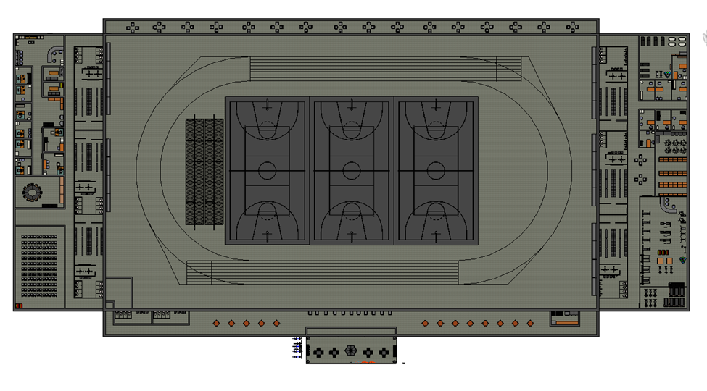
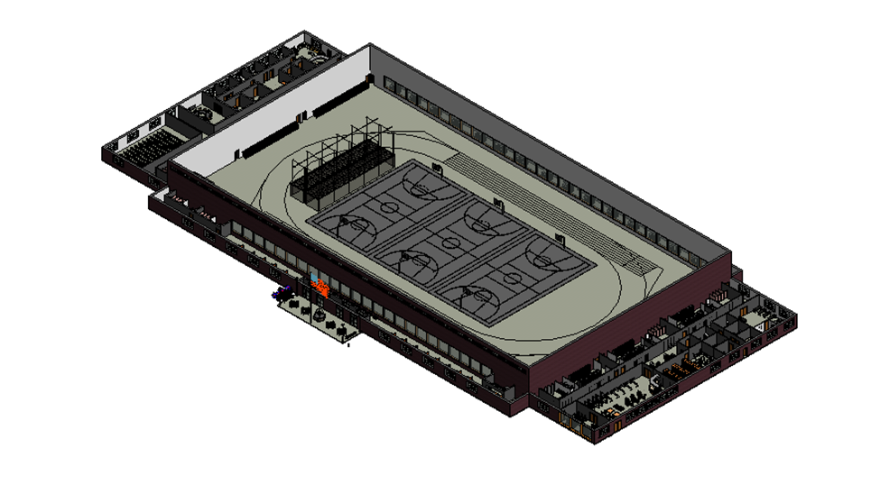
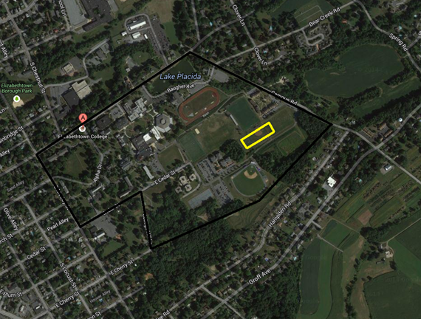
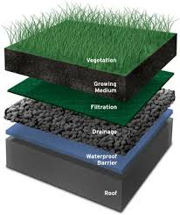
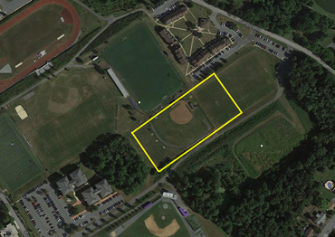
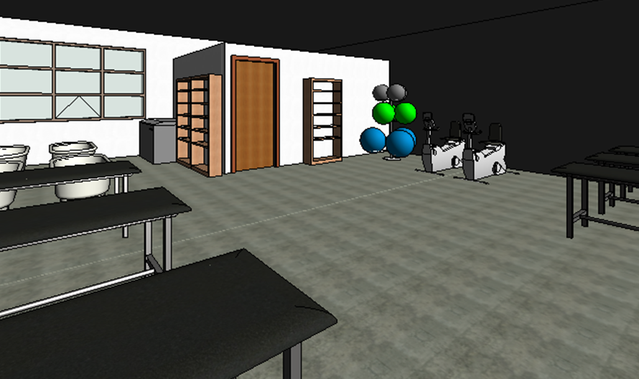
Elizabethtown College Wellness Center
Jake Evans, Tommy James, Buck Kauffman
EGR 343: Green Architectural Engineering
Elizabethtown College, Elizabethtown, PA
Project Constraints
Design Features
Structure
Approximately 100,000 sq. ft. building
Brick exterior
Fitness Facilities
200m indoor Track, NCAA regulation to hold meets
3 multipurpose surface regulation basketball courts
6 Locker rooms for varsity sports/ student body and faculty use
Weight room with free weights and machines, attached cardio room with treadmills, bikes, etc.
Large room for group fitness classes (Yoga, Pound, Zumba, etc.)
Wellness Facilities
Counseling services for the greater student body
Training room for athletes and students in need of treatment
Classrooms for wellness courses and Athletic film
Religious Space/Additional Facilities
Quiet sacred space for religious activities and reflection
OSA offices for intramural sports and other activities
Offices for coaches and other athletic officials
Fit on 775’ X 230’ site
Include fitness area (Physical wellness), Counseling services (Mental wellness), Religious space (Spiritual wellness)
Green Building techniques, Apply for LEED certification
Reasonable for construction and budget
Create Dining venue to create another campus “hub”
Green rooftop garden for water and heat control
Sensitive land protection
Rainwater collection
Usage of recycled and low emitting materials
Large windows, “clerestory” type, for natural daylight
Rooftop solar panels
Weight room
LEED Self-assessment highlights
Counseling waiting area
North side final view
Basic floor plan
Exposed aerial view
Front view from existing soccer game field
Site selection relative to campus
Green rooftop structure

